Slide 1

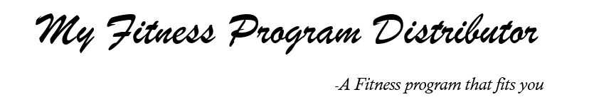
My Fitness Program Distributor 7/2/2019
Team members:
Duc Nguyen (Product Owner), Tunglin Lee (Scrum Master),
Dongpyeong Seo, Tarun Sivakumar, Matthew Stone, Cameron Rabiyan

Slide 2
Outline of problem/opportunity
For people who are busy and don’t have the time to come up with a workout program of their own
Users can choose a pre-written workout program.
The workout program of their choice would then be emailed to them.

Slide 3
High-level goals
Searching Users are able to efficiently choose a workout program they want.
Customizing Users are able to efficiently create their customized workout program.
Feedback Users are able to give/get feedbacks for their workout programs

Slide 4
Sprint 1
User Stories
As a powerlifter, I want to see programs only related with power-lifting so that I don’t have to check the entire result page for a workout program.
As a fitness beginner, I want to know the level of difficulty of workout programs so that I can check if it is within my range of capabilities.
As a user interested in only each routine, I want to know information about only specific routine so that I don’t have to commit to an entire workout program
Spikes
Learn basics of front-end UI development
HTML, CSS, JS, …
Learn basics of backend development
Web frameworks (like Flask in Python)
Database
Learn fitness workouts and their characteristics

Slide 5
Sprint 1
Infrastructure tasks (acquiring tools, setting up environment)
Set up a GitHub repo
Set up a server using AWS
Set up Python Flask as a web framework library
Set up a MySQL Database
Set up a DB schema for workouts & routines
Fill out DB with well-organized workouts & routines

Slide 6
Sprint 2
User Stories
As an experienced fitness user, I want to design my own customized program since the provided programs do not align with my goals.
As a user, I want to export my workout program to my email so that I don’t need to re-visit the website and search for my program again when I exit the browser.
Spikes
Learn email API and try to apply it in back-end
Learn browser-side JS for the complicated logics in front-end
Learn advanced UI design with HTML, CSS, JS
Infrastructure tasks
Apply front-end libraries (jQuery, bootstrap, …) to our service
Set up a email account of our service

Slide 7
Sprint 3
User Stories
As a user, I want to upload the workout program I designed for others to use because I have gotten great result from it.
As a user, I want to give feedback to workout programs that are provided so that other users can see reviews before committing to a workout program.
As a user designing a personal workout program, I want some recommendations/guidelines that I can refer to while I am designing my workout program so I know I am efficient.
Spikes
Learn basics of authentication logic
Design proper UI & policy for our feedback system
Infrastructure tasks
Modify DB schema to cover uploaded workouts and feedbacks

Slide 8
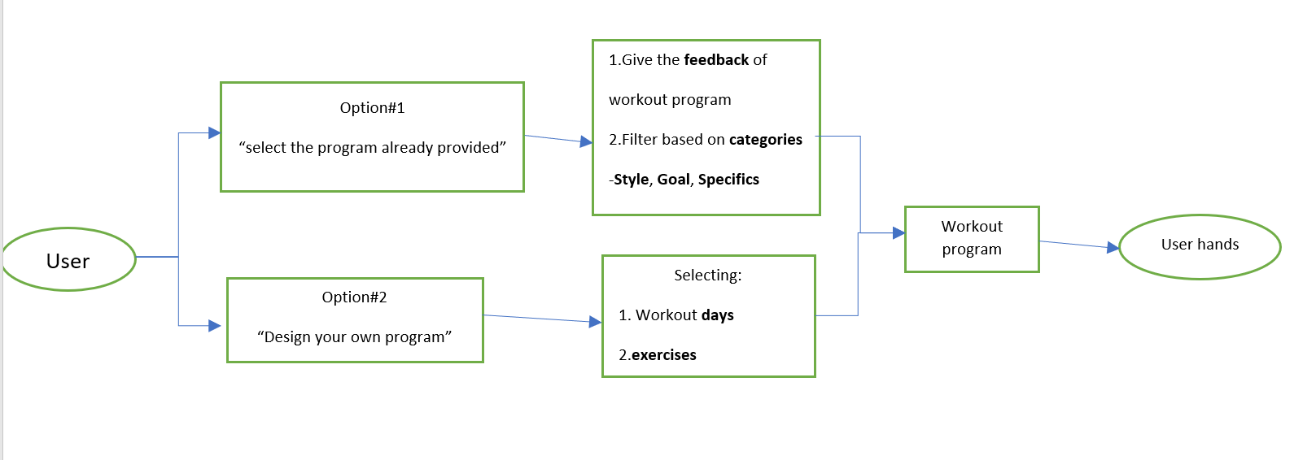
Service Architecture

Slide 9
Challenge / Risk 1
Organizing the database of workout program
Why?
We are not experts of designing every workout programs, nor certified fitness trainers.
Need to design what attributes should contain in Database

Slide 10
Challenge / Risk 2
Making a good interactive UI
Why?
Not too many experiences with front-end programming

Slide 11
Technologies
Front-end
HTML, JavaScript, CSS, Bootstrap, …
Back-end
Amazon Web Services (AWS)
Python (with Flask), MySQL, …
GitHub
Slack

Slide 12
Minimum Viable Product
Users can choose pre-written workout programs
Users can design their own workout programs
The workout programs will be exported to their email
By the time of the release, our product should be able to export some kind of workout program (prewritten or user designed) to the customer via email.

